Slide 1
LSA Conference 2023 Examining Australia’s Uniform Defamation Laws using the lenses of law reform, technology, human rights and case law arising from social media platforms
Justine Hanks
Rule of Law Education Manager

Slide 2
Courts Update The story to date
Chief Magistrate/ Judge/ Justice
Office of the Sheriff
Court Services
Administrative Staff/ judicial associates
Sydney Courts closed to the public (and schools) in response to Covid-19 from March 2020​
In 2020, RoLEC worked with NSW Supreme Court, District Court and Sheriffs to create the Virtual Law Day Out​
RoLEC approached Sydney Courts numerous times to develop a Covid-Safe experience for students. This would replicate the programs run in other States, particularly Victoria for the provision of a remote gallery to watch live court cases or pre-recorded recent cases of key parts of a trial eg giving evidence, bail applications etc​
End of 2022, most of the Sydney Courts were open to the public, however there were building capacity limits, jury trial bubbles, continuing covid protocols that vary across the court hierarchy etc which have made a full return for students to Courts difficult. ​
RoLEC has worked closely with the Courts and Sheriffs to find ways to balance open justice with the safe operation of justice. We successfully ran 6 trial excursions in November and December 2022 and have, with their permission been able to offer a limited amount of Court Excursions to the Downing Centre in 2023. ​

Slide 3
Court Experience Excursions
Law Day Out Program - Downing Centre
No Commerce groups – Legal Studies students only
LDO only available at this stage due to accompanied nature of experience
Limit of 45 students per day and strict 1:20 teacher:student ratio imposed by courts
Groups strictly limited to one level at a time (Levels 4 and 5 at once for Local Court)
Prohibited matters for school groups – any cases of a sexual nature or involving children in any courts across the state, any jury trials in the District Court. Unfortunately this is approximately 80% of cases held in the District Court at Downing Centre.
Parramatta complex is currently unavailable due to high security nature of some matters scheduled in the building
We are awaiting word from the Supreme Court as to whether judicial officers are able to speak with school groups and if we can take groups into the building as part of the LDO experience
Court Visit Program
No Commerce groups – Legal Studies students only
Still not able to book Court Visits in Downing Centre or Parramatta due to logistical issues of having unaccompanied groups within the complex
We are awaiting word from the Supreme Court as to whether school groups can visit unaccompanied. Entry is at the discretion of the presiding justice and schools will need to make contact with associates of listed cases before attending to ascertain accessibility

Slide 4
Court Experience Excursions
Regional/ Other Courts
No Commerce groups – Legal Studies students only
Schools can make contact with the Registrars of larger court complexes in regional areas to make arrangements, but permission is at the discretion of the Registrar.
We are receiving mixed reports of accessibility across the state. If you are allowed or denied access, please let us know as we are feeding this back to the Office of the Sheriff in our efforts to improve accessibility for regional schools.
Larger complexes are identifiable by the presence of both Local and District Courts in the complex (e.g. Newcastle, Gosford, Wollongong, Coffs Harbour, Grafton, Nowra, Wagga Wagga, Griffith etc)

Slide 5
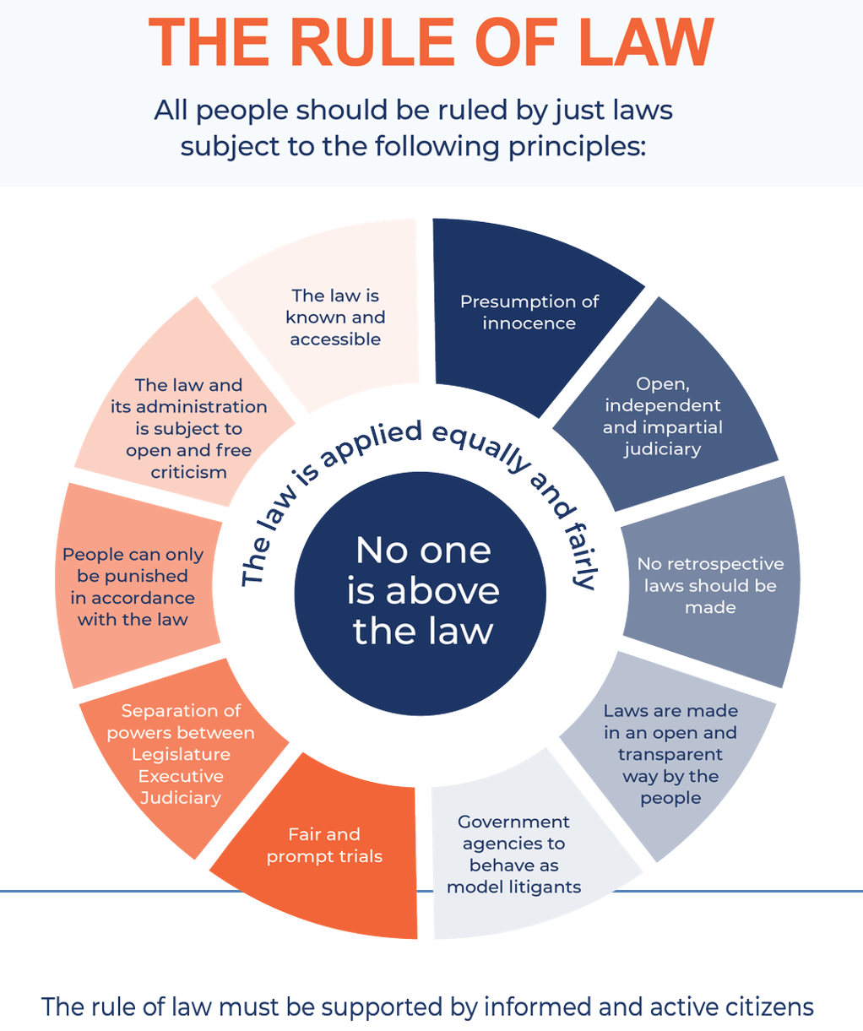
What is the Rule of Law?

Slide 6
The relationship between the ROL and the Syllabus using the criteria for effectiveness
ROL Principle | Criteria to Evaluate Effectiveness
The law is known and accessible | Enforceability; Accessibility; Application of ROL
Presumption of innocence | Protection of individual rights; Has justice been achieved?
Open, independent and impartial judiciary | Enforceability; Responsiveness; Protection of Individual Rights; Has justice been achieved?
No retrospective laws should be made | Responsiveness; Meeting society’s needs
Laws are made in an open and transparent way by the people | Responsiveness; Meeting society’s needs; Accessibility
Government agencies to behave as model litigants | Application of the ROL; Meeting society’s needs
Fair and prompt trials | Resource efficiency; Enforceability; Protection of individual rights
Separation of powers between Legislature, Executive and Judiciary | Meeting society’s needs; Protection of individual rights; enforceability
People can only be punished in accordance with the law | Protection of individual rights; Application of ROL; Resource efficiency
The law and its administration is subject to open and free criticism | Protection of individual rights; Application of ROL; Has justice been achieved?

Slide 7
Why defamation?
Rapidly growing number of cases related to technology, particularly related to social media platforms.
Demonstrates limited responsiveness legislation to rapid technological change but adaptability of common law.
Area of need for law reform that is growing rapidly, and will also be impacted by developments in AI – who is actually responsible for the generation of defamatory content when an AI tool is used to create it? What about neurotechnology AI?
Raises issues related to rule of law principles:
The law is known and accessible – if precedent is the main regulation despite there being legislation, how well known is that by a ‘reasonable person’? How accessible are civil remedies for individuals?
Fair and prompt trials – growing number of civil cases causing increases in delays across courts impacting on fairness for parties and prompt resolution of issues between parties. Has also reduced resource efficiency in courts as many matters should be able to be settled our of court if the legislation addressed gave clarity on resolving smaller disputes and provided for ADR.
People can only be punished in accordance with the law – while civil law does not have punishments, there are remedies – how consistent would these be across matters and jurisdictions given the differing natures of platforms, commentary, audiences etc? Very hard to measure the parameters of harm in cases of reputation (eg Bazzi v Dutton).
The law and its administration is subject to open and free criticism – lagging legislative regulations are impacting on court loads and individual rights (privacy, good reputation, freedom of expression), justice for plaintiffs/ defendants may be delayed due to complexity of cases, difficult to ascertain the reach of defamatory content making compensatory damages difficult, and the permanency of material – global removal very difficult if not impossible (issues of compliance and enforcement with court orders made by Australian courts).

Slide 8
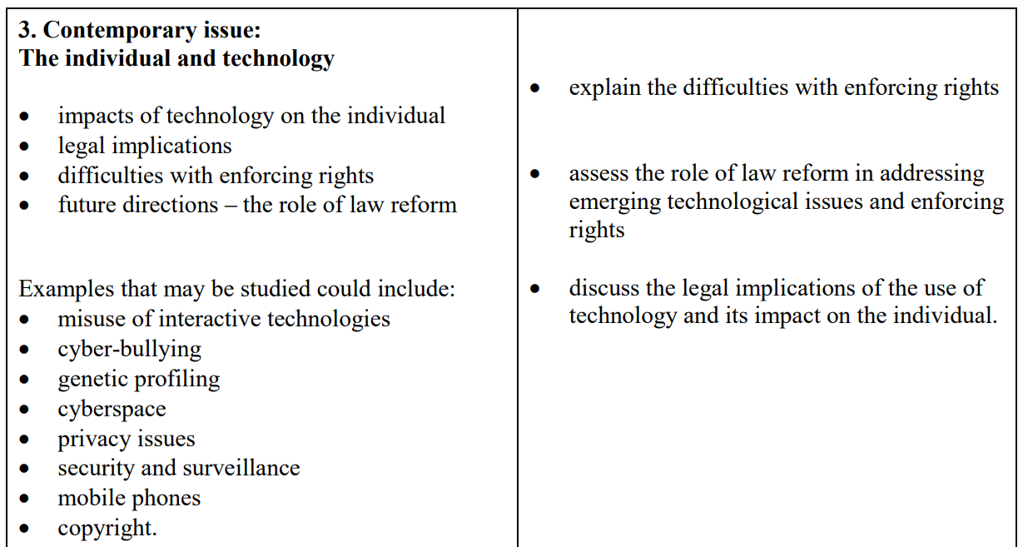
Making use of a defamation resource in the NSW Syllabus
NSW Preliminary Legal Studies Syllabus
2009
Part II: The Individual and the Law
Themes and Challenges:
Relationship between rights and responsibilities
Role of the law in regulating technology
Effectiveness of legal mechanisms for achieving justice for individuals and society
Part I: The legal system
Themes and Challenges:
The need for law in the operation of society

Slide 9
Making use of a defamation resource in the NSW Syllabus
NSW Preliminary Legal Studies Syllabus
2009
Part III: Law in Practice
Themes and Challenges:
The development and reform of law as a reflection of society
The importance of the rule of law
The responsiveness of the legal system in dealing with issues
The effectiveness of legal and non-legal mechanisms in achieving justice for individuals and society
Relevant Effectiveness Criteria
enforceability
resource efficiency
responsiveness
protection of individual rights
meeting society’s needs
application of the rule of law
has justice been achieved?

Slide 10
Application of the ROL to Uniform Defamation Legislation - Law Reform
Pre 2005 Defamation Legislation
The law and its administration is subject to open and free criticism
Law reform and the introduction of new legislation is this rule of law principle in action.
In response to criticism of existing law and its inability address issues, law reform or the creation of new legislation acts to close gaps that are impacting upon the harmonious functioning of communities and effectiveness of the justice system.
Law reform demonstrates the separation of powers in action. The legislature is fundamental in instigating new legislation or amending existing legislation.
State/ Territory | Legislation
Australian Capital Territory | Civil Law (Wrongs) Act 2002, Ch 9
New South Wales | Defamation Act 1974
Northern Territory | Defamation Ordinance 1938, 1963 and 1964; Defamation Act 1989
Queensland | Defamation Act 1889
South Australia | Civil Liability Act 1936
Tasmania | Defamation Act 1957
Victoria | Wrongs Act 1958
Western Australia | Libel Act 1843 (UK); Newspaper Libel and Registration Act 1884; Newspaper Libel and Registration Act 1884 Amendment Act 1888 Criminal Code Act 1913
The Defamation Act 2005

Slide 11
Reform of the Uniform Defamation Legislation
Slow moving
Reactive not proactive
2005
Uniform Defamation Laws passed (enacted Jan 2006) by all states and territories, except ACT where it was incorporated into Ch 9 of the Civil Law (Wrongs) Amendment Act 2006
2020
Defamation Amendment Act 2020 (enacted throughout 2021 by all states and territories except WA and NT) was passed to address issues of excessive payments, introduced the need for plaintiffs to serve concerns notices to potential defendants to reduce cases before the courts, the establishment of a single publication rule to limit payouts and the introduction of a new defence of public interest.
2023
Proposed changes (anticipated to be enacted 1 Jan 2024) have been approved in principle by the Standing Council of Attorneys-General.
These include provisions for internet hosting providers, internet caching and storage service providers, and search engine providers (such as Google), the inclusion of an innocent dissemination defence for internet intermediaries and a simple complaints notice process for the removal of content and the provision of powers to courts to make orders against non-parties to prevent access to defamatory materials online.
These changes are expected to have the effect of reducing claims and recoveries due to the financial limitations of individual originators as payment is not certain, changes to complaints policies by social media platforms, privacy issues for content originators where complainants are provided with their details by intermediaries and increased use of ADR to resolve disputes

Slide 12
Application of the Uniform Defamation Legislation reforms in the context of the Syllabus – Law Reform
Conditions:
Across jurisdictions:
Inequity in outcomes
Accessibility to civil remedies varied
The variance in definitions of what was considered a defamatory statement
Matters that occurred across jurisdictions became complex and costly very quickly
‘Jurisdiction shopping’ by plaintiffs in multi state matters for the optimal outcomes
All of these factors were affecting equality, accessibility to remedies, recognition of individual rights and fairness
Agencies:
Federal government pushed for change in 2004 and the Standing Committee of Attorneys General created draft Model Defamation Provisions for the UDL in the same year
Mechanisms:
State and territory parliaments passed legislation in 2005, enacted in January 2006
B) Contemporary Law Reform Issue
You could challenge your students to look at the topic ‘Social media and the law’ for their issue taking into account other areas of regulation needed or completed in the area of social media – advertising, freedom of expression, privacy laws, employment law etc

Slide 13
Making use of a defamation resource in the NSW Syllabus
NSW HSC Legal Studies Syllabus
2009
2. Promoting and enforcing human rights
Part II of the core: Human Rights
Themes and Challenges:
The development of human rights as a reflection of changing values and ethical standards
The role of law reform in protecting human rights
The effectiveness of legal and non-legal measures in protecting human rights

Slide 14
Making use of a defamation resource in the NSW Syllabus
NSW HSC Legal Studies Syllabus
2009
ICCPR
The legislation upholds Articles 17 and 19, but to what extent does it promote and enforce these rights? Is this an effective legal measure to protect human rights?
Article 17 (1) No one shall be subjected to arbitrary or unlawful interference with his privacy, family, home or correspondence, nor to unlawful attacks on his honour and reputation.
Article 17 (2) Everyone has the right to the protection of the law against such interference or attacks.
Article 19 (1) Everyone shall have the right to hold opinions without interference.
Article 19 (2) Everyone shall have the right to freedom of expression; this right shall include freedom to seek, receive and impart information and ideas of all kinds regardless of frontiers, either orally, inwriting or in print, in the forms of art or through any other media of his choice.
Article 19 (3) The exercise of the rights provided for in paragraph 2 of this article carries with it special duties and responsibilities. It may therefore be subject to certain restrictions, but these shall only be such as are provided by law and are necessary:
For respect of the rights or reputations of others;
For the protection of national security or of public order (ordre public), or of public health or morals.

Slide 15
Application of the ROL to Uniform Defamation Legislation Complications arising from social media
Social Media Use 2005
Social Media Use 2022
Social Media Platform | Estimated number of users (2005)
Facebook | 1 m globally
YouTube | Launched Dec 2005
WhatsApp | Founded 2009
Instagram | Founded 2010
LinkedIn | Australian launch 2010
Snapchat | Founded 2011
Twitter | Founded 2006
Tiktok | Founded 2016
Social Media Platform | Estimated number of Australian users per month (millions)
Facebook | 18
YouTube | 17.5
WhatsApp | 12
Instagram | 10
LinkedIn | 6.5
Snapchat | 6.4
Twitter | 5.8
Tiktok | 1.1
Various Sources
Source: Social Media News, April 2022
@ 23.6m internet users Australia wide
@ 21.45m Social media users in Australia, averaging 7.2 platforms per user (May 2022, Meltwater Analytics)

Slide 16
Application of the ROL to Uniform Defamation Legislation Complications arising from social media
Complications that arise from social media impact upon fairness and equity in outcomes for individuals, and can hinder the promptness of trials.
Some complications include
The unfiltered nature of commentary opens the door for increased cases of defamation arising from social media interactions.
User anonymity can be a complication for individuals finding the source of commentary, further complicated by the use of fake names, birthdates and emails used to create accounts.
Who is the publisher? Did a third party see the commentary? (ever growing body of ‘surprise’ videos asking for help or gift giving could also lead to defamatory statements when people are unaware they are being filmed).
The grapevine effect – determining the reach and spread of content can be complicated and will affect damages outcomes for applicants.
Transnational nature of SM companies – head office vs subsidiary offices – creates complications for accountability and enforceability. They are also able to afford litigation compared to the individual.
Enforcement and compliance of orders made by Australian courts in other jurisdictions may be impossible to achieve, as may be removal of content that has already ‘gone viral’ across platforms – eg TikTok videos shared across other platforms.
An emerging area that may also increase the caseload under the legislation is Technology-facilitated coercive control (TFCC), including perpetrators ability to access past partners accounts to create posts or fake accounts that make defamatory statements and commentary about past partners online.

Slide 17
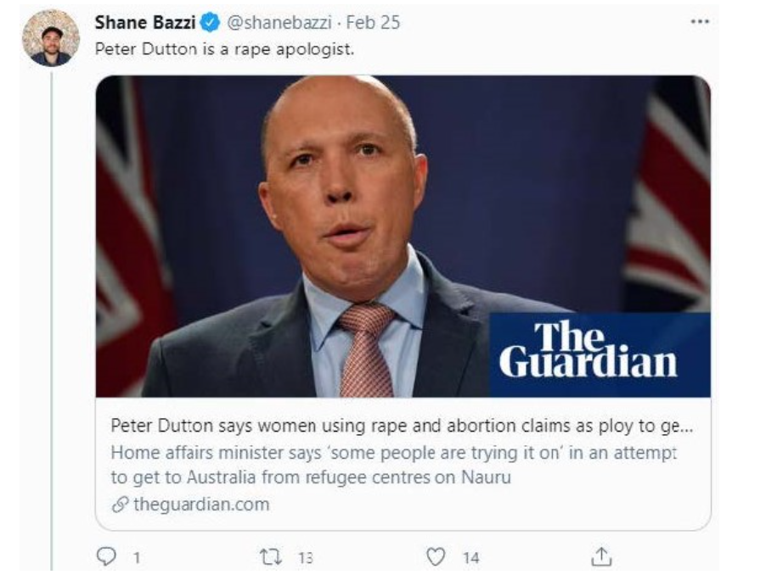

Slide 18
Bazzi v Dutton [2022] FCAFC 84
Initial judgement in the Federal Court made in favour of Dutton by White J in Dutton v Bazzi [2021] FSC1474
The defendant, Bazzi, was ordered to pay $35,000 to Dutton. His Honour had focussed on the words written by Bazzi, and the decision was appealed based on this.
Bazzi v Dutton [2022] FCAFC 84 – appeal granted by the FCAFC.
Rares, Rangiah and Wigney J found that Tweet comments made by Mr Bazzi about Mr Dutton being a rape apologist were not imputations as they did not convey to the regular reader that Mr Dutton excuses rape. The Full Court found that the primary judge had erred in focussing on the Tweet comment made by Mr Bazzi and it's meaning rather than the comment and link posted together, which altered the context of the comment.
“It follows that Mr Bazzi’s comment in the first line of the tweet must be understood in the context of what is conveyed by the words (and image) in the extract from The Guardian article, not as something distinct or separate to it. The ordinary reasonable reader, scrolling quickly through his or her Twitter feed, would consider the tweet as a whole and would have read and understood Mr Bazzi’s comment in the first line having regard to the material that appeared as part of the incorporated extract from The Guardian article. The incorporated extract was as much a part of the tweet as the first line.”
Wigny J at [63] Bazzi v Dutton [2022] FCAFC 84
Judgement by White J in Dutton v Bazzi [2021] FSC1474 in favour of Dutton was set aside

Slide 19
Relevant Australian Case Law
Case Name | Jurisdiction or court | Platform | Details | Damages
Fairfax Media Publications Pty Ltd, Nationwide News Pty Ltd &Australian News Channel Pty Ltd v Voller [2021] HCA 27 https://www.abc.net.au/news/2021-09-08/high-court-rules-on-media-responsibility-over-facebook-comments/100442626 | High Court | Facebook | Video footage from ABC Four Corners episode published on FB pages of news outlets. Comments made on those pages by third parties deemed to be defamatory and the media companies liable for those comments as the facilitators of the pages | Settled March 2022 – undisclosed sum Also important from a law reform perspective to note that this case led to the Royal Commission into the protection and detention of children in the NT
Burrows v Houda [2020] NSWDC 485 https://ramsdenlaw.com.au/news/defamation-battle-an-emoji-is-worth-a-thousand-words/ | NSW | Twitter | Comments made using emoji’s to communicate the belief the plaintiff had committed acts of misconduct. | For the plaintiff. Costs only awarded.
BeautyFULL CMC Pty Ltd v Hayes [2021] QDC 111 https://www.queenslandjudgments.com.au/caselaw/qdc/2021/111 | Qld | Instagram (stories) | Defamatory assertions made by a former employee of a cosmetic medical centre that clearly identified the clinic and made claims of dishonesty and physical assault. | For the plaintiff’s, awarded a total of $85,222
Martin v Najem [2022] NSWDC 479 https://obriensolicitors.com.au/australian-cyber-security-centre-food-blogger-eats-words-after-court-orders-defamatory-posts/ | NSW | Instagram (stories) | Food blogger defamed by a rival influencer on a number of occasions, referring to him as a racist and pedophile | For the plaintiff $300,000 and a permanent injunction

Slide 20
Relevant Australian Case Law
Case Name | Jurisdiction or court | Social Media Platform | Details | Damages
Nettle V Cruse [2021] FCA 935 | Federal Court | complaintwire complaintsboard internetcheaters | Dr Nettle, a Sydney based plastic surgeon was defamed over a number of websites. Judge Wigney found that these were calculating and designed to inflict the maximum damage of his professional reputation. | $450,000 compensatory and aggravated damages however, the respondent cannot be located
Dean v Puleio [2021] VCC 848 | Vic | Google reviews | Respondent published 4 reviews on Google which were found by Judge Clayton to be serious imputations, ‘but not of the most serious kind’. | $170,000 compensatory and aggravated damages
Lee & Ors v Sheen & Anor [2021] QDC 18 | Qld | WeChat | The plaintiff, a Brisbane lawyer, sued the defendant over a publication made on the Chinese social media platform. | $60,000 compensatory and aggravated damages
Gair and Turland v Greenwood [2020] NSWDC 586 | NSW | YouTube | A resident of a shire council published a video on YouTube making statements regarding the plaintiffs, a Mayor and former Deputy Mayor of the shire council | $100,000 compensatory and aggravated damages
Doak v Birks [2022] NSWDC 625 | NSW | Facebook | Comments and video posted on a group page for rodeo events. 204 comments and 163 emoji responses. Available to 1959 Facebook friends for 81 days. | For the plaintiff $283,358.79 in general, aggravated and special damages
Many more cases can be found at:
https://www.australian-defamation-lawyers.com.au/reported-cases/
https://stephens.com.au/damages-for-online-defamation-recent-cases-updated-august-2021/

Slide 21
Contact Us
Contact
Justine Hanks
Education Manager
justine@ruleoflaw.org.au
Court Experiences Contact
courtvisit@ruleoflaw.org.au
General Information and Questions
Rule of Law Education
info@ruleoflaw.org.au
education@ruleoflaw.org.au
Website
www.ruleoflaw.org.au

